Slide 1


Introduction to Statistics
Session 1: The Hard Part is Getting Started

Slide 2




Intro
Henry Häkkinen
Post-Doc studying the effects of climate change on seabirds and how to plan effective conservation. Latterly branched out into impacts of renewable energy on biodiversity.

Slide 3
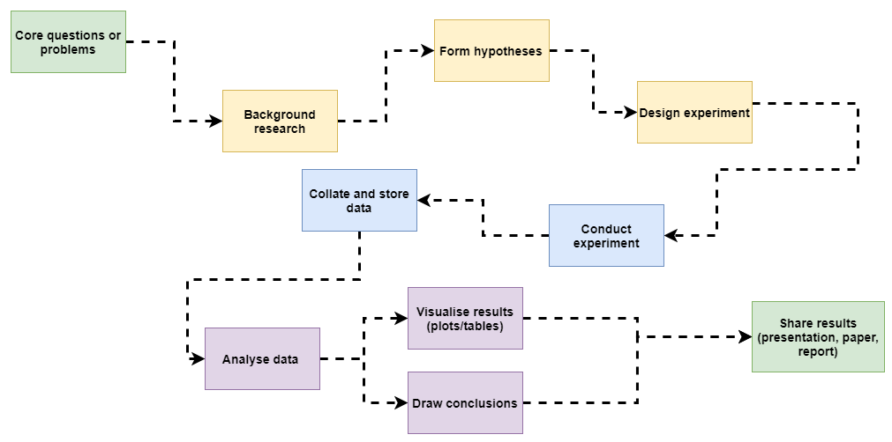
What are statistics?
We’re focussing on this bit

Slide 4
What are statistics?
We’re focussing on this bit
“To consult the statistician after an experiment is finished is often merely to ask him to conduct a postmortem examination. He can perhaps say what the experiment died of.”
-Ronald Fisher,
Presidential Address to the First Indian Statistical Congress, 1938

Slide 5
In this session…
Introduction to statistical theory
Creating a statistical toolkit
Understanding basic tests
Making a basic statistical workflow
Interpreting output
Building statistical literacy and next steps
Work through examples in R.

Slide 6


What is not in this session…
Lots of mathematics
Detail on lots of individual tests
Comprehensive coverage of all statistical concepts.

Slide 7
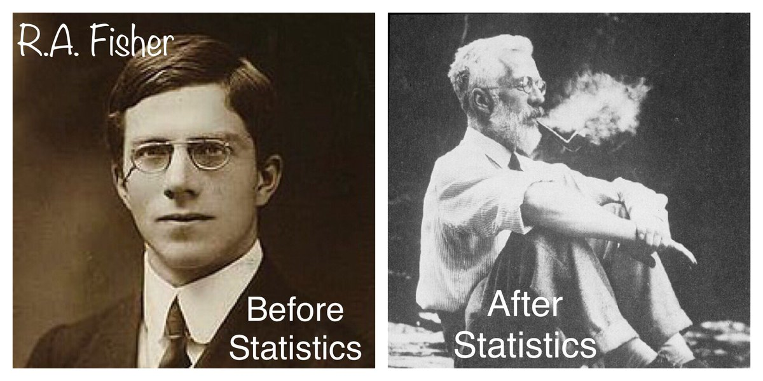
PART 1: Why do we learn statistics?
Notes:
ACTIVITY: ask the room what they use statistics for? Why do we use them rather than just look at data?

Slide 8
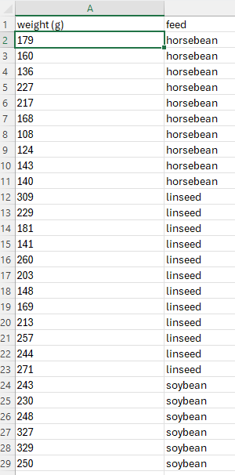
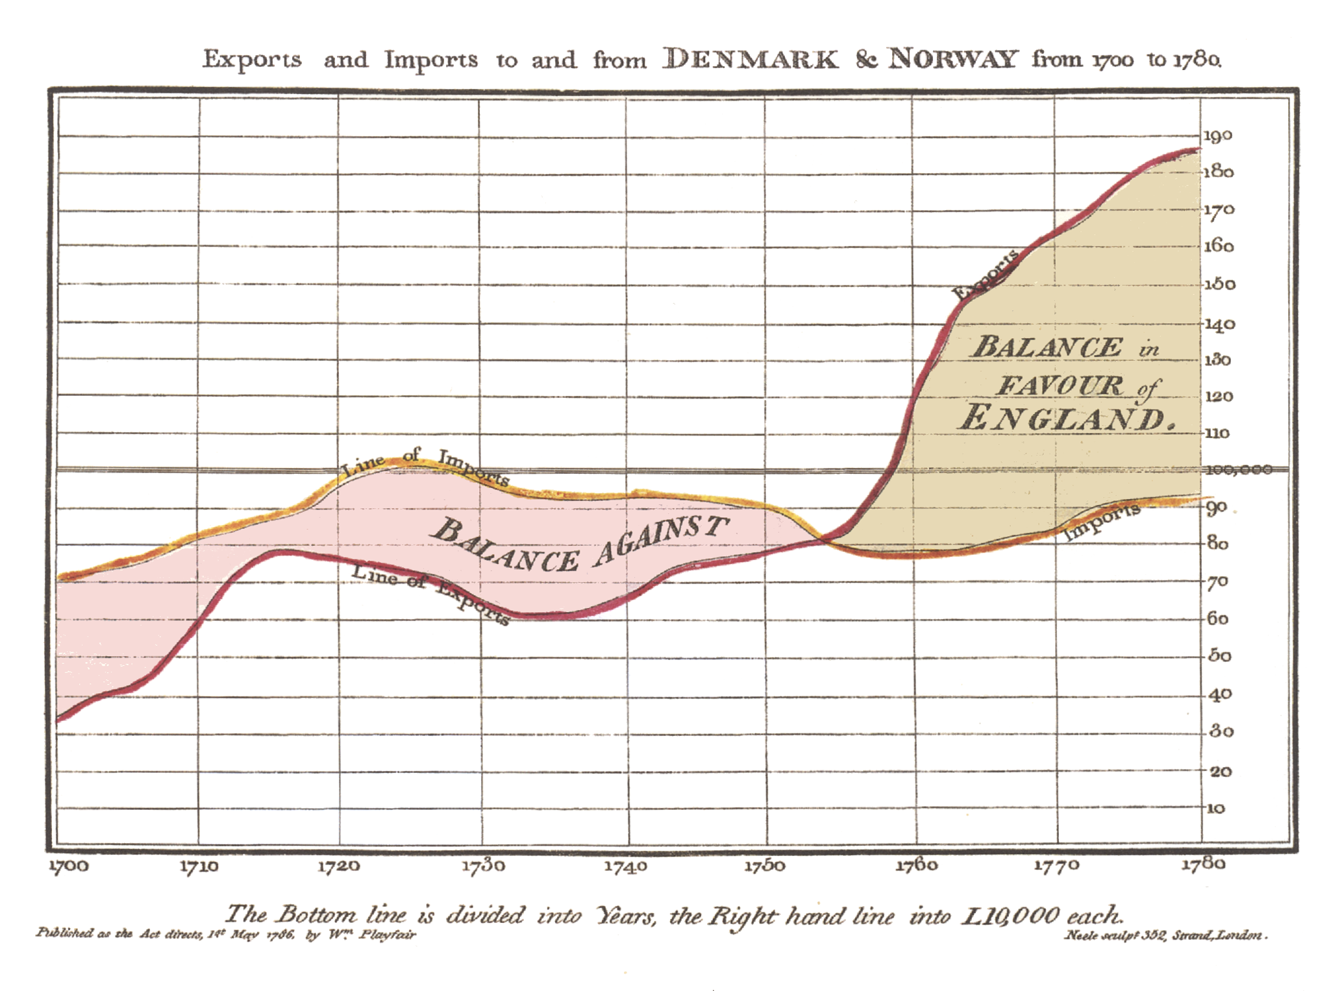
What are statistics?
The collection, organization, analysis, interpretation, and presentation of data
It is not easy to make conclusions from raw data alone, even with plots
We could use common sense and nothing else to make conclusions.
BUT human judgement is prone to error and biases. We use statistics as a tool to limit the impact of our own biases.
https://commons.wikimedia.org/wiki/File:Playfair_TimeSeries-2.png

Slide 9
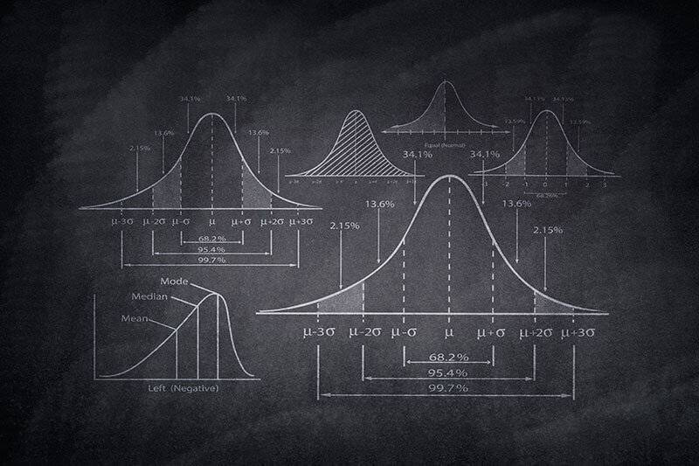
What are statistics?
In science, we often use “statistics” as short-hand for “inferential statistics” which examines properties of data in relation to underlying probability distributions
This includes hypothesis testing! And most forms of classical models!
“Descriptive statistics” summarise data in a compact, easily understood fashion
Include things like mean, median, mode
They do not tell us anything about probability or confidence

Slide 10


Why do we learn statistics?
Literacy is needed to understand existing literature
Bad practice is common; you need to be able to spot it!
Helps you design experiments and data collection.
Ecological data tends to be messy, and having a lot of available “tools” makes analysis a lot easier

Slide 11
The Good News
Nearly all statistical tests follow shared fundamental principles
Learning your first few tests can be difficult, but over time this gets easier and easier.
Building a solid theoretical base will make your life a LOT easier later on.

Slide 12
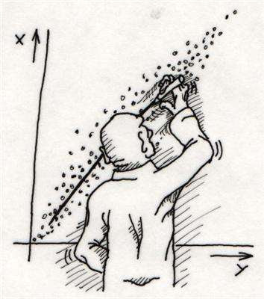
PART 2: Basic Theory

Slide 13

Before you run your test
Understand your data
Understand your hypothesis
Select a sensible statistical framework

Slide 14
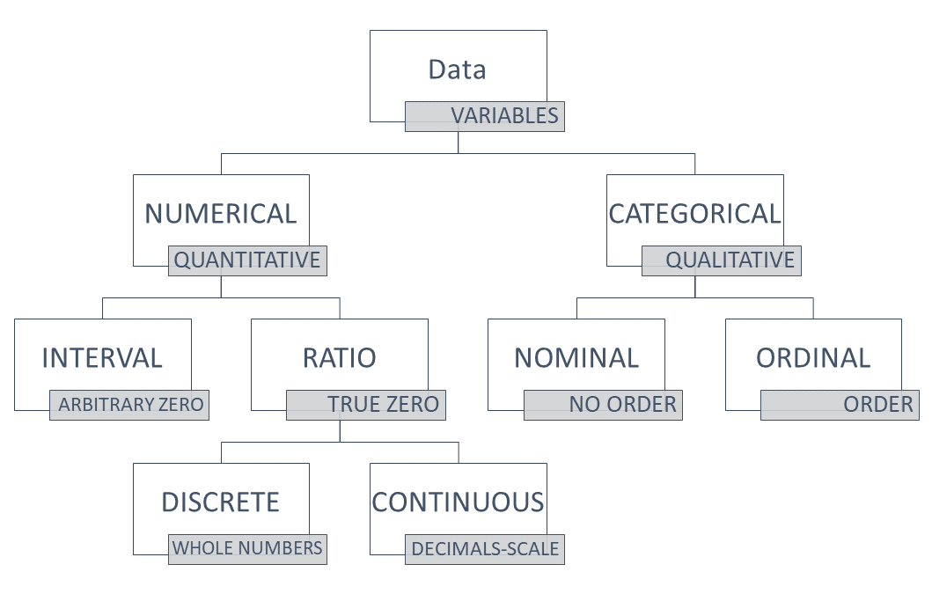
Types of Data
Notes:
ACTIVITY: ask for examples from people

Slide 15
Types of Data
Can take any numerical value, including decimals. May be bounded at 0.
Length
Height
Distance
Speed

Slide 16
Types of Data
Can take any numerical value, but must be whole number. “Integer” in coding terminology
Count data
Number of days/years
Shoe size

Slide 17
Types of Data
Categories that are functionally independent and mutually exclusive
Sites
Eye colour
Favourite food
Blood type
Success/Failure (1/0) binary is a special case!

Slide 18
Types of Data
Categories that have a clear order
Highest qualification (school to PhD)
Likert scale (Strongly Disagree to Agree)
Rank

Slide 19
Basic Notation
Standard notation is to have our response variable (what we are measuring) on the y axis
Our predictor (what we are varying/controlling) is shown on the x axis
This plot also has a second, categorical predictor named “group”
Standard notation for this statistical model would be:
y ~ x + group
Response (or Dependent) Variable
y
x Predictor (or Independent) variable

Slide 20

ACTIVITY
We gather a number of radioactive spiders of different species, each of which vary in size, radioactivity, age and leg number. Each volunteer is bitten by a radioactive spider, we monitor them, and we observe any superpowers they develop
QUESTIONS:
what is our response variable? What are some reasonable predictors?
What type of data is our response variable?
Notes:
Activity: get class to formulate a model from this information. Pair and share

Slide 21
Descriptive Statistics
Raw data is often difficult to interpret or explain easily.
Descriptive statistics provide easy to understand summaries and overviews

Slide 22
Descriptive Statistics
There are many ways to summarise data, but two very common methods are to study averages and variance
Averages (central tendencies) include mean, median, and mode
Variance describes the spread of data around the average (typically the mean).
Other key descriptions include range, interquartile range and various other quartiles.

Slide 23
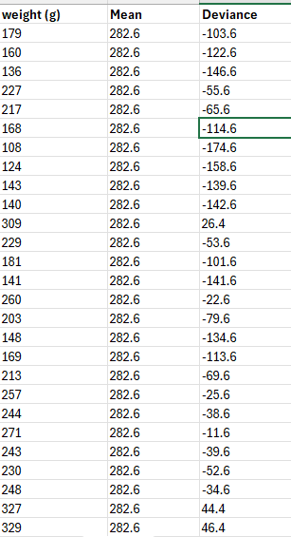
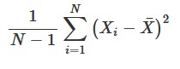
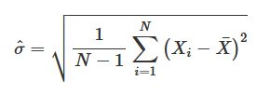
Descriptive Statistics
Variance of the data is simply how far (on average) is each observation from the mean (squared).
6095.503
Very mathematically useful, but completely impossible to interpret.
So we use the Standard Deviation, which is the square root of the Variance
78.07

Slide 24
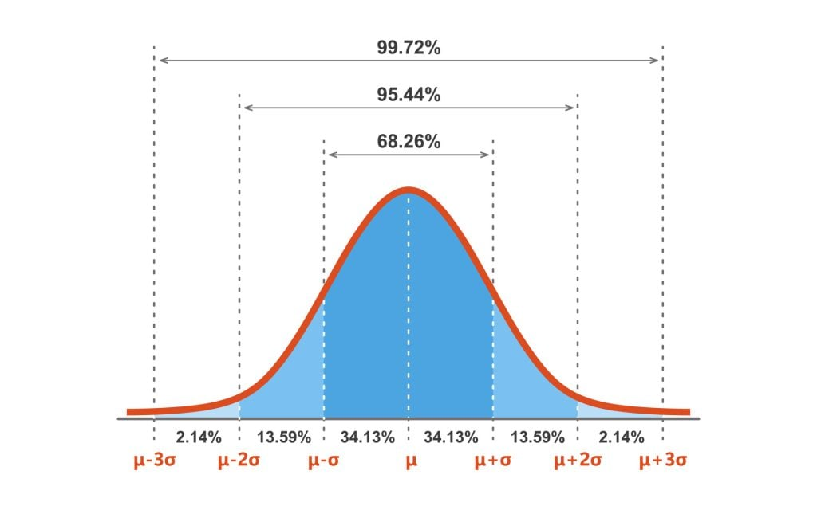
Descriptive Statistics
The Standard Deviation has some very useful properties, especially if your data resembles a bell curve
68% of data will be within 1 SD of mean
95% of data will be within 2 SD

Slide 25
Descriptive Statistics
Intuitive description:
A low SD means most individuals are close to the mean
A high SD means most individuals are very different to the mean

Slide 26
PART 3: Probability and Distributions

Slide 27
Inferential Statistics
Probability describe the chance of an event, or set of events, occurring
It assumes we know all the relevant underlying information about the event
We predict the data from what we know
Inference estimates the probability of observed data
We have the data, but we don’t know the relevant underlying information about what made it
We infer information about the events

Slide 28
Probability
For example:
If we have a standard coin, what is the probability that we flip 10 heads in a row?
We know all the relevant information about the system, i.e. the probability of flipping heads once is 0.5 (50%)
From there we can calculate:
0.5^10 = 0.009765625 -> ~1%

Slide 29
Inferential Statistics
A very simple example of inference:
A coin is flipped 5 times. We get heads every time.
There are two possible reasons:
The coin is weighted
We were very lucky
We have the observation data, but do not know about the underlying probability
We have to infer information about this system.

Slide 30
Inferential Statistics
We can work out the probability we were very lucky:
p = 0.5^5 = 0.03125
There is a ~3% chance we would see 5 heads in a row on a fair coin.
Is this enough to make a conclusion?
In statistics we often use a threshold for significance, known as a p-crit.
This is often 0.05 (5%) but this is arbitrary!
Since 0.03 is less than our p-crit (0.05), we conclude there is strong evidence the coin is weighted
BUT we cannot be certain either way.

Slide 31
The Binomial Distribution
What you just saw was a very simple example of binomial distribution. With it we can calculate the probability of an event (0/1 outcomes) based on our data.

Slide 32
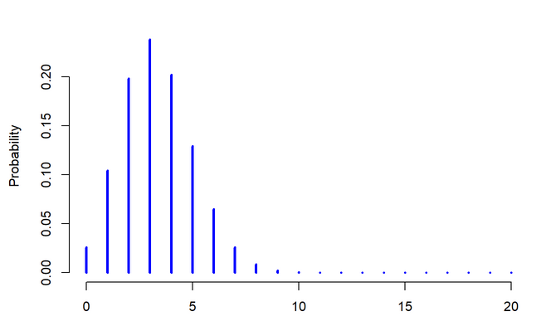
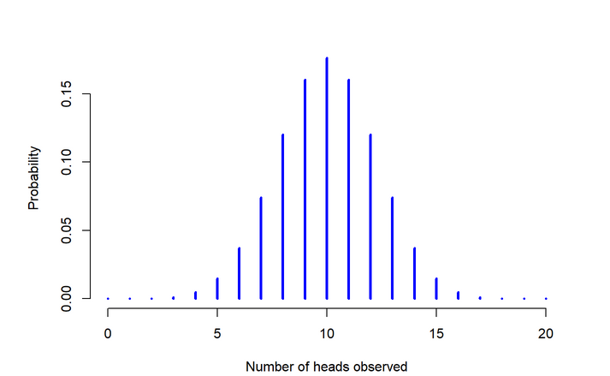
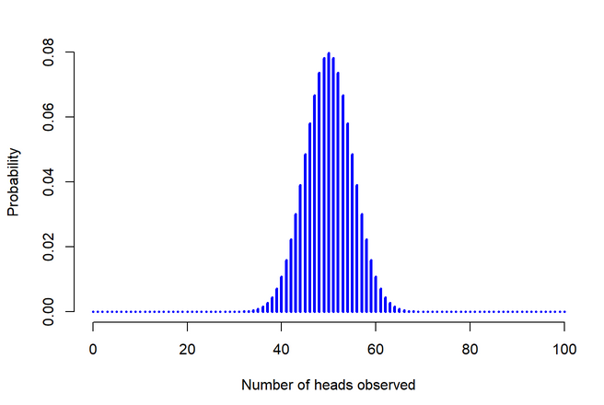
The Binomial Distribution
Every distribution can be formally described, and has some key parameters and assumptions.
The general form of the binomial distribution is X∼Binomial(θ,N)
X is the observed results
N is the number of trials (e.g. number of time the coin was flipped)
Θ is the probability of success (e.g. probability of flipping heads)
We can plot the outcomes of our trials to see what a binomial distribution looks like:

Slide 33
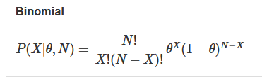
The Binomial Distribution
We can go further!
We can work out the probability of seeing our data, for a given value of θ.
Often, we want to estimate the probability our null hypothesis is true. To do this, we estimate p, which is the probability that the data we observe is completely random and there are no underlying “weighted” parameters.

Slide 34
Distributions
For a binomial distribution, converting from data to probability and back again is relatively easy
But this is a lot more complicated with most other types of data. “Distributions” are designed to allow to convert between properties of our data and probability.
BUT this means we have to make sure our data fits our selected distribution. If it doesn’t, it screws up all our calculations of probability.

Slide 35
Quick Summary
We have covered a number of core concepts:
Types of data
Thinking about standard notation, null and alternative hypotheses
Working out our first p-value
And looked at our first distributions.
Let’s look at another example, closer to actual ecological data!

Slide 36
PART 4: Running a Model

Slide 37

Data example!
A research team has found two previously undiscovered populations of flying whales in Antarctica.
The team have gathered data on their length, age, location, population and local intensity of background magic (i.e. an environmental variable).
They wish to investigate whether the two populations may be different species. As a simple start they want to know if the average lengths of the two populations differ
Source: Sampo Jumisko

Slide 38
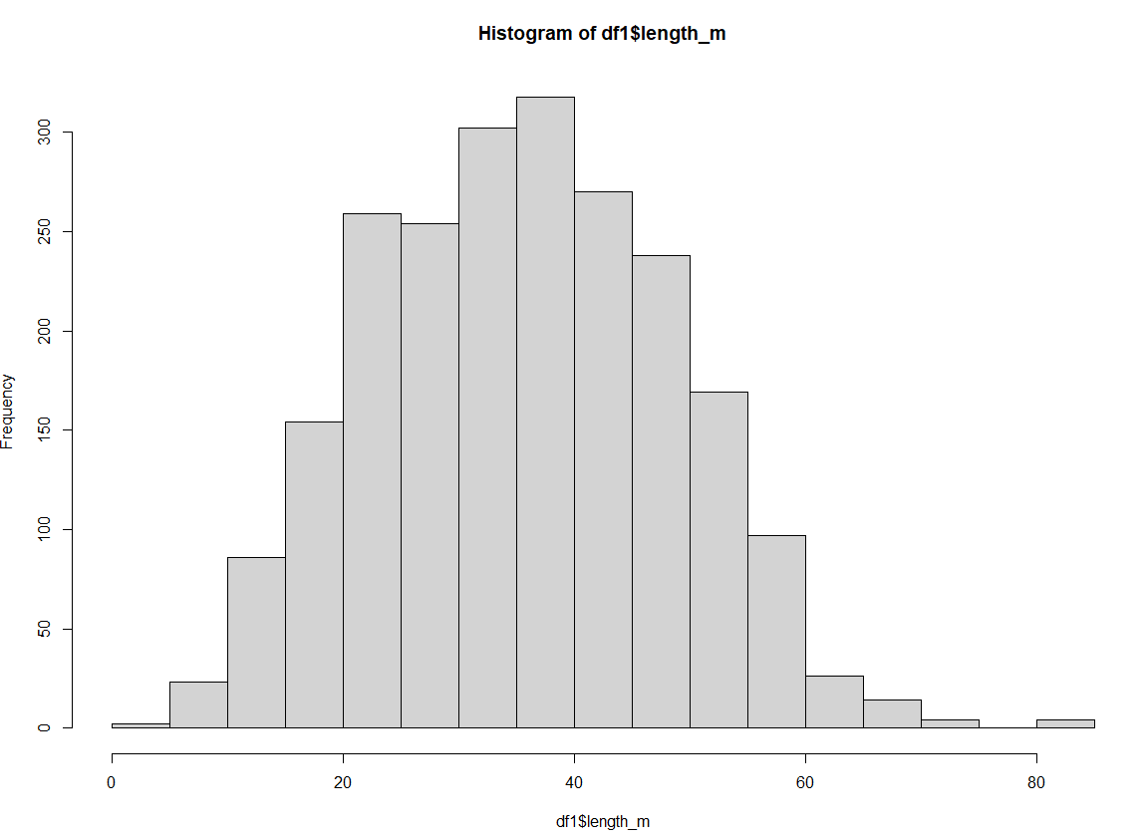
Data example!
Our model equation:
Length ~ population
Note: there are two populations
Histogram of response variable:

Slide 39
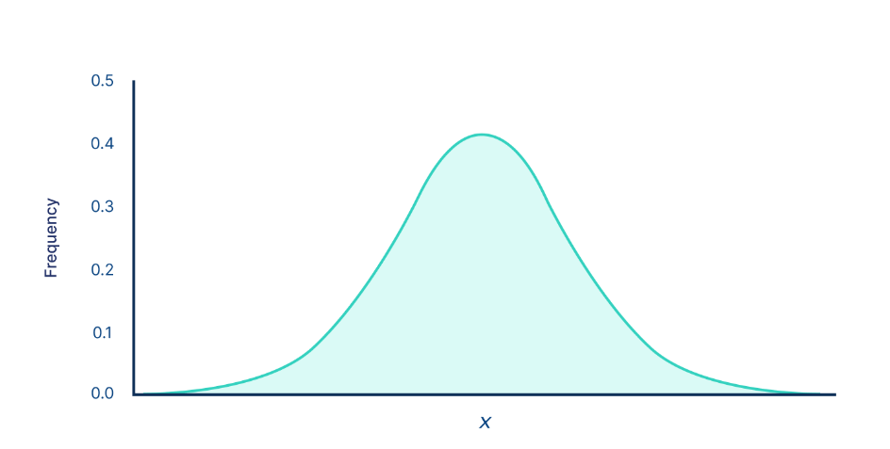
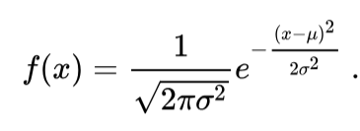
Data distributions
Normal (aka Gaussian) distribution
Continuous response variable:
Length of population
Time of migration arrival
Intelligence
Two parameters: mean (µ) and standard deviation (σ)
General form:
X∼Normal(μ,σ)

Slide 40
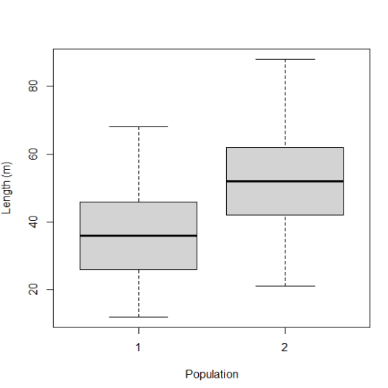
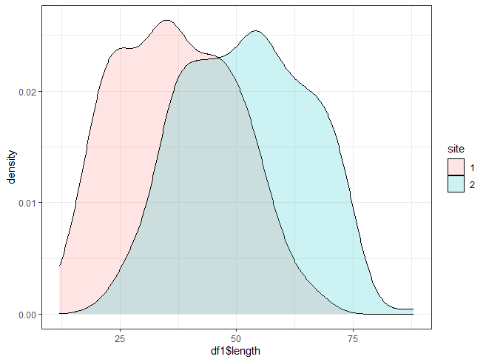
We want to compare the length of flying space whales in population 1 and population 2.
Our null hypothesis is: the average length of a whale in population 1 is the same as in population 2. i.e. there is no difference (on average) between populations
We assume that our data approximately fits a normal distribution

Slide 41
Am I using the right distribution?
Make sure you know the type of data you are working with (continuous, count etc.)
Plot the data. Plot the data. PLOT THE DATA!
Use experience/text books/search engines to find possible distribution in R
How closely your data matches a distribution matters less if your dataset is large
If in doubt, run the test, you can check afterwards whether the model “fits” your data.
We will come back to this later….

Slide 42
Running a test!
We assume the response variable (length) is approximately a normal distribution
Our predictor is population, which is categorical
There are 2 categories (Site 1 and Site 2)
So let’s feed our statistical formula into R:
Length ~ Population

Slide 43
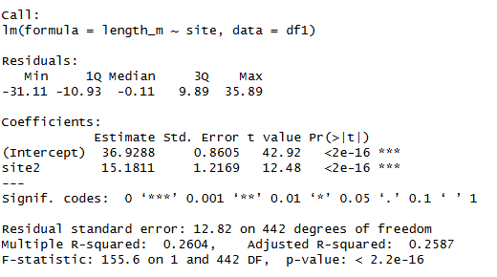
Running a test!
The output:
Notes:
ACTIVITY: ask people to interpret output

Slide 44
Running a test!
The output:
Model formula
Mean length of site 1
Standard error
p-value
Difference between mean of site 1 and site2
Notes:
ACTIVITY: ask people to interpret output

Slide 45
Diagnosing a test
Is our job done? No!
We have to check the model is actually working properly, and our distribution is the correct choice
To do this we can run diagnostics after performing a statistical test
But before that we have to explain “residuals”:

Slide 46
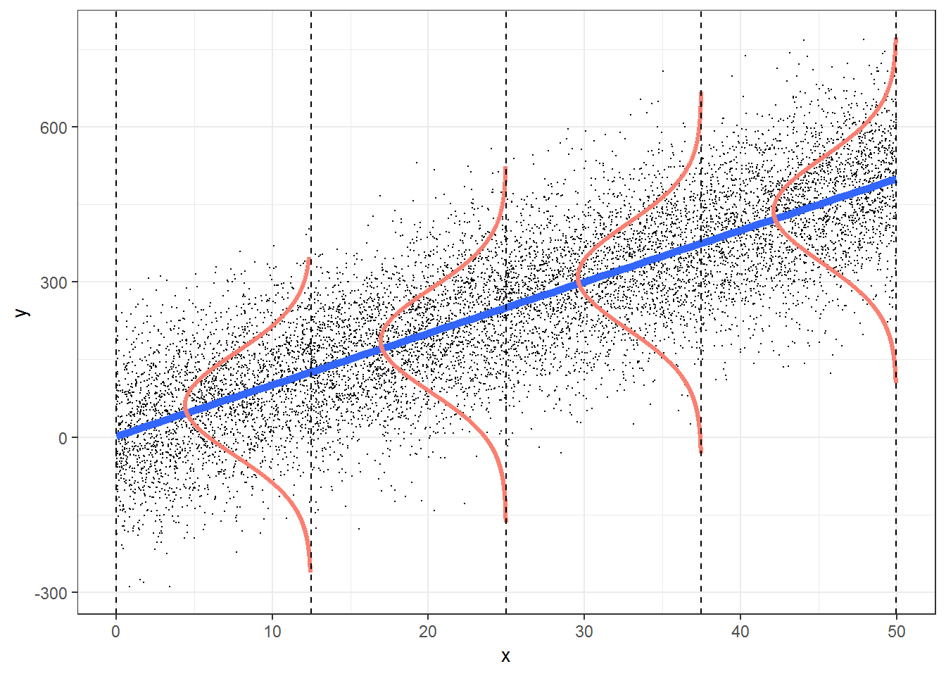
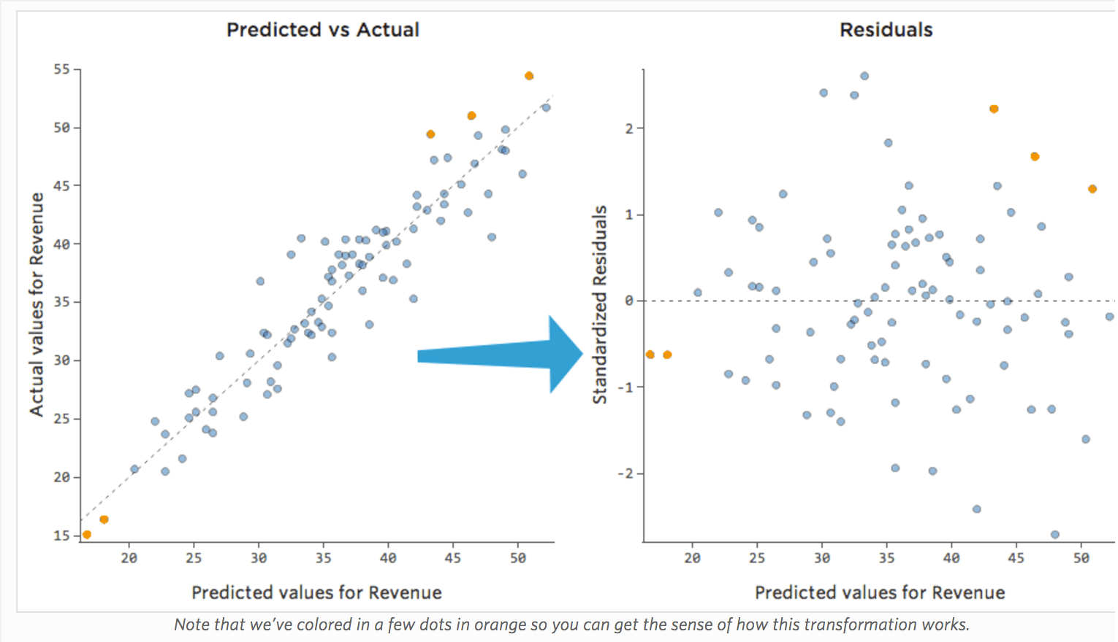
Diagnosing a test
Residuals measure the difference between “what the model predicts” and “what does the data says”
No model is perfect so you will always have some residuals
Residuals should be random and (typically) are normally distributed.
Any systemic patterns in your residuals indicate there is a mismatch between your model design and your data
https://statistics4ecologists-v2a.netlify.app/linreg#lmassumptions

Slide 47
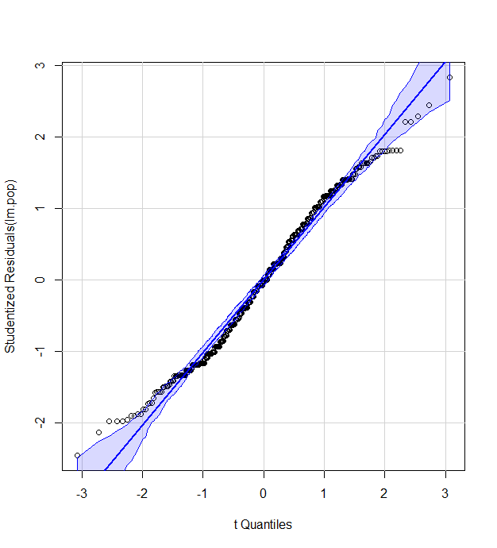
Diagnosing a test
R has a lot of tools to visualise residuals, here is one of them for our simple test
In this very simple model, the only source of error is the choice of distribution.
A perfect normal distribution would fit on the dotted line
Deviations away from this line indicate this is not a normal distribution
This is not a great plot, but good enough I would consider it acceptable!

Slide 48
When modelling goes wrong
Remember a key assumption is our data fits our chosen distribution. If it does not, then the test is flawed
We check that our model fits our data well, diagnostic plots and inspecting residuals are key to this. But what do we do when we find our model design is bad?
One option: pick another distribution
How do we know which to use?
Experience
Searching online or in R documentation

Slide 49
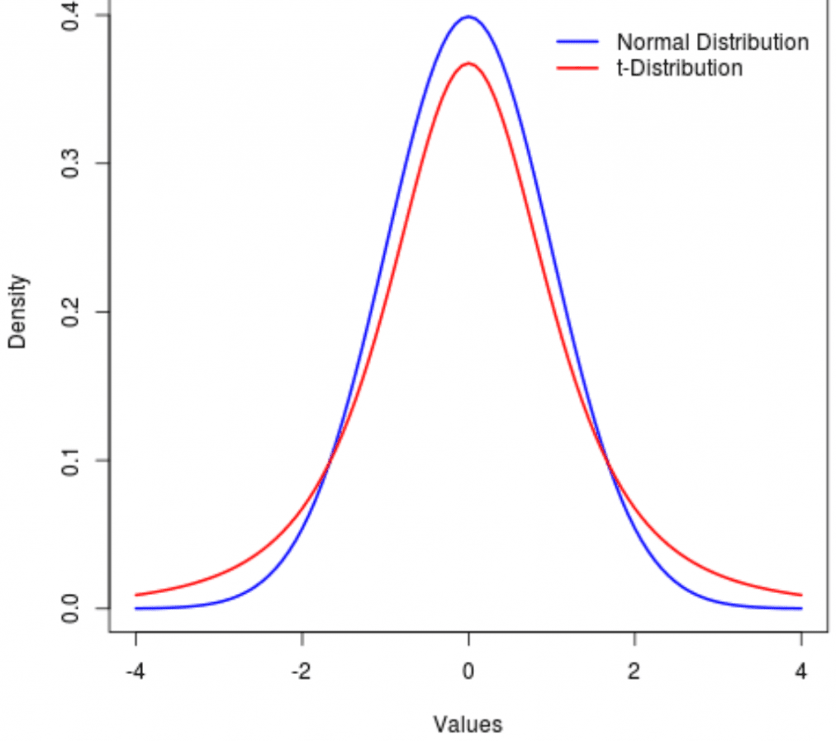
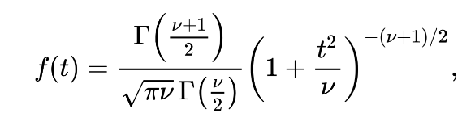
Data distributions
Student’s t-distribution
Extremely similar to normal distribution
BUT better at handling wider variance and small samples
Continuous response variable:
Length of population
Time of migration arrival
Intelligence
Two parameters: degrees of freedom (v) and gamma function (Г)

Slide 50
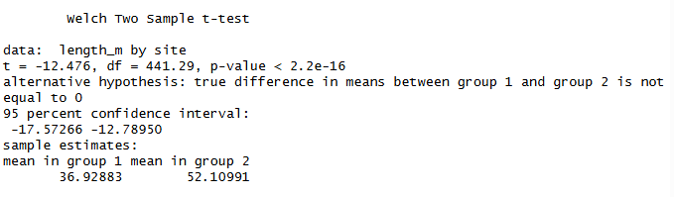
Data distributions
Student’s t-distribution
In this case gives same answer
Makes sense as t-distribution is very similar to a normal distribution
Surprise: we just did a t-test!

Slide 51
Reporting statistical tests
Describe the result, state the hypothesis result, and state the details of the test.
“On average, whales from population 1 were 36.9m in length (n=222; SD=12.6), while those from population two were 52.1m (n=222; SD=13.1). A Student’s t-test found a significant difference in length between the two populations (t=-12.5, df=441.39, p<0.001).”

Slide 52
Recap
Steps to making a statistical test:
Think about our study system, identify our response and our predictors and make a formula
Make plots of our data (especially our response variable), and select a distribution.
Check our data fulfils the assumptions of the distribution
Run chosen statistical test
Check the diagnostics and residuals
Consider alternative distributions if necessary
Interpret our output

Slide 53
Side note: sub-tests
One of the reasons learning statistics can be confusing is because we have to sift through decades of work and a lot of confusing terminology.
I generally advise people to ignore names, and focus on
the type of data you have
the distribution of the response variable

Slide 54
Side note: sub-tests
Many tests have variants that account for different scenarios, unfortunately they often have different names and (I think) needlessly confusing
For example, there are many sub-types of t-test:
One-sample t-test
Student’s (Independent Samples) t-test
Paired Sample t-test
Welch’s t-test
One/Two tailed t-test
If you come across a test with many sub-types, learn the basic form first. Then investigate if a sub-type is specifically needed for your data/hypothesis.

Slide 55
Next steps
Response variables is… | Predictor | Response variable distribution | Possible test
Binary (0/1) | 1 or more categories | binomial | Binomial test
Continuous | 2 categories | Normal OR t-distribution | Linear model with 2 categories OR t-test
Continuous | >2 categories | Normal | Linear model with >2 categories OR ANOVA
Count | >=2 categories | Chi-squared | Chi-squared test
Continuous | Continuous | Normal | Linear Regression

Slide 56
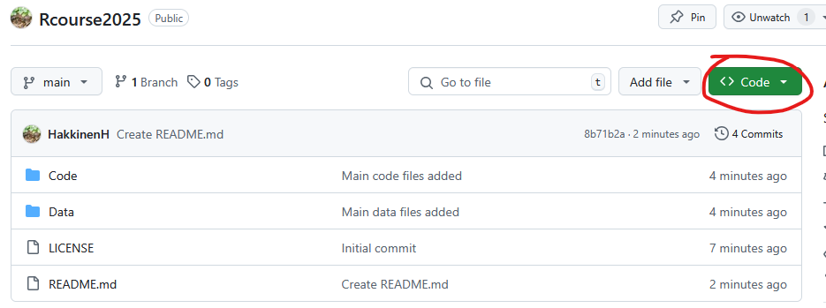
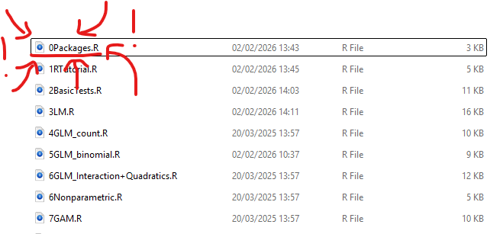
The Practical: Part 1
https://github.com/HakkinenH/RStatsCourse2026
Code -> download ZIP -> Unzip and put somewhere useful
Run 0Packages.R first (if you haven’t already) to install packages
Optional: if you want some practice with basic R, then work through 1RTutorial.R first
Work through 2BasicTests.R as your first example

Slide 57
PART 5: Linear Models

Slide 58
Data example!
A research team has found several previously undiscovered populations of flying whales in Antarctica.
The team have gathered data on their length, age, location, population and local intensity of background magic (i.e. an environmental variable).
They wish to investigate what variables might explain their enormous size.
Source: Sampo Jumisko

Slide 59
Check list
Steps to making a statistical test:
Think about our study system, identify our response and our predictors and make a formula
Make plots of our data (especially our response variable), and select a distribution.
Check our data fulfils the assumptions of the distribution
Run chosen statistical test
Check the diagnostics and residuals
Consider alternative distributions if necessary
Interpret our output

Slide 60
Data example!
Step 1: Think about our study system, identify our response and our predictors and make a formula
Response: length
Predictors: magic, age, location (east or west)
Let’s make some other plots for our data

Slide 61
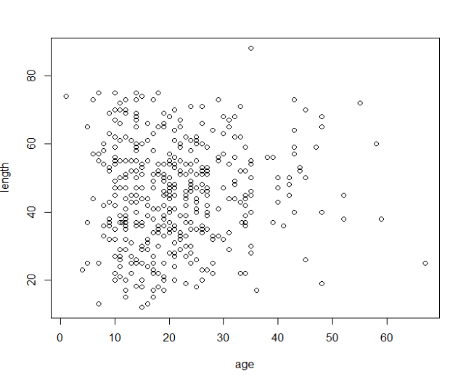
Correlation
For categories we used mean, median, SD etc. as descriptive statistics
For pairs of continuous variables we can also use correlation coefficients
NOT a statistical test, it’s descriptive
Several variants, most common are Pearson’s and Spearman’s

Slide 62
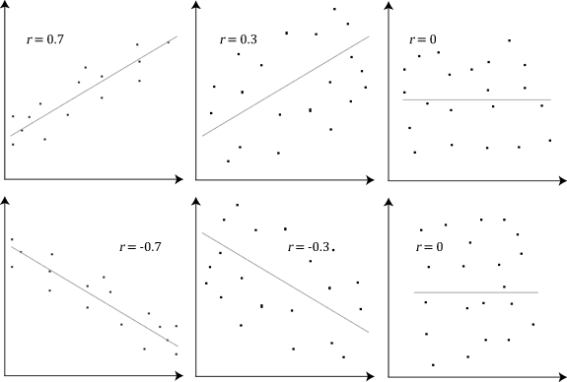
Correlation
Most standard correlation coefficients are from -1 to 1
0 means no correlation
-1 means perfect negative correlation
+1 means perfect positive correlation
R-squared is just correlation squared, commonly reported in linear models

Slide 63
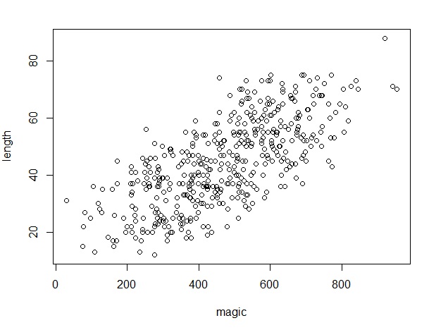
Correlation
Age vs Length: Pearson’s r =0.07
Magic vs Length: Pearson’s r =0.71
So our initial exploration suggests there might be a relationship between magic and length, but not age and length

Slide 64
Data example!
Step 2: Make plots of our data (especially our response variable), and select a distribution
Continuous response: normal distribution
Continuous predictor: [distribution doesn’t matter]
Categorical predictor: [distribution doesn’t matter]
Chosen model: linear model with a normal distribution

Slide 65
Check model assumptions
Check our data fulfils the assumptions of the distribution. (I looked them up online)
The sample is representative of the population at large.
The response variable is normally distributed
There are no substantial outliers
The predictors are all linearly independent (they do not substantially correlate with each other)
There is sufficient data to carry out the test (rule of thumb: 10-20x more data than variables)
There is a linear relationship between the independent variable(s) and the dependent variable.
The independent variables are measured with no error (i.e. they are fixed effects).
Mean of the distribution of errors are 0.
The variance of the residuals is constant across observations (homoscedasticity).
The residuals are uncorrelated with one another.

Slide 66
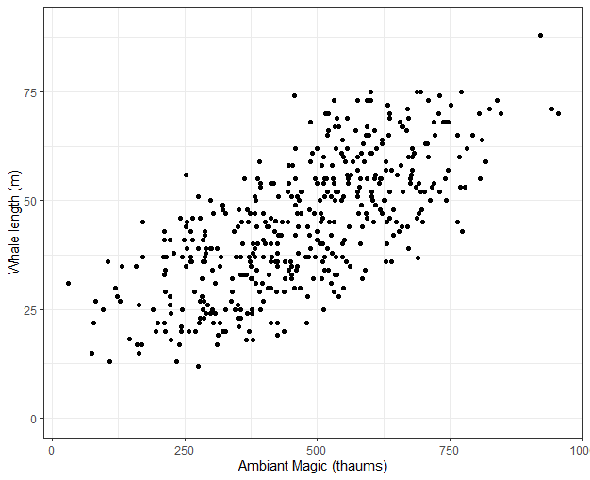
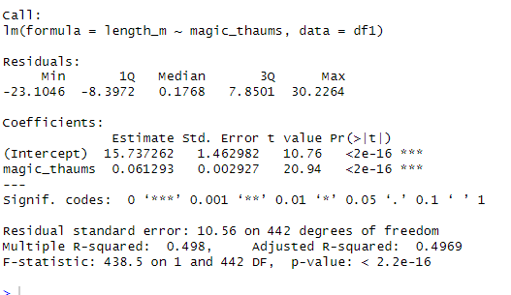
Data example!
Step 3: Run chosen statistical test (simple version)

Slide 67
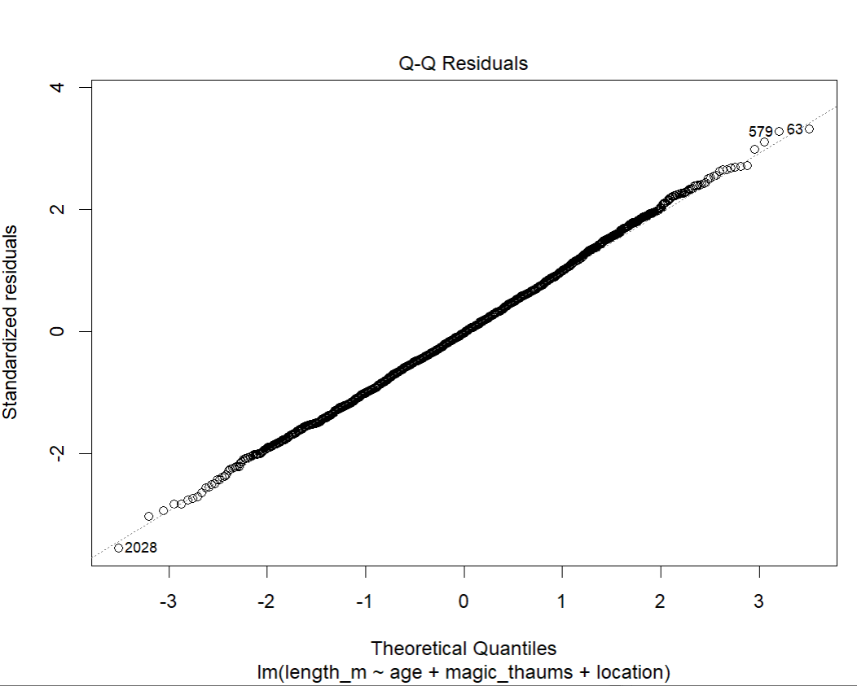
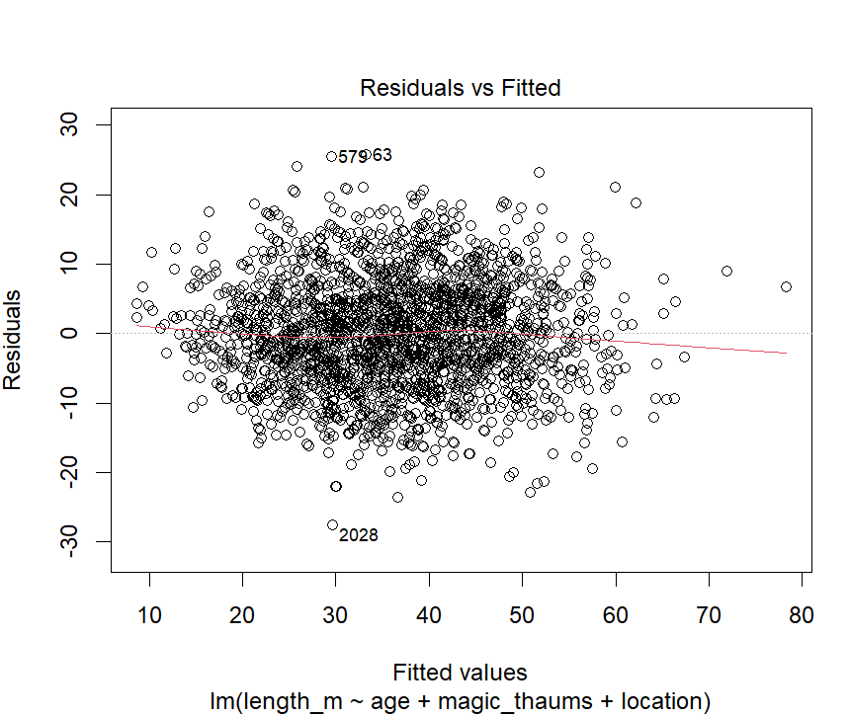
Data example!
Step 4: Check the diagnostics and residuals
Notes:
Activity: what are we looking for?

Slide 68
Reminder: residuals
Residuals measure the difference between “what the model predicts” and “what does the data says”
No model is perfect so you will always have some residuals
Residuals should be random and (typically) are normally distributed.
Any systemic patterns in your residuals indicate there is a mismatch between your model design and your data
https://statistics4ecologists-v2a.netlify.app/linreg#lmassumptions

Slide 69
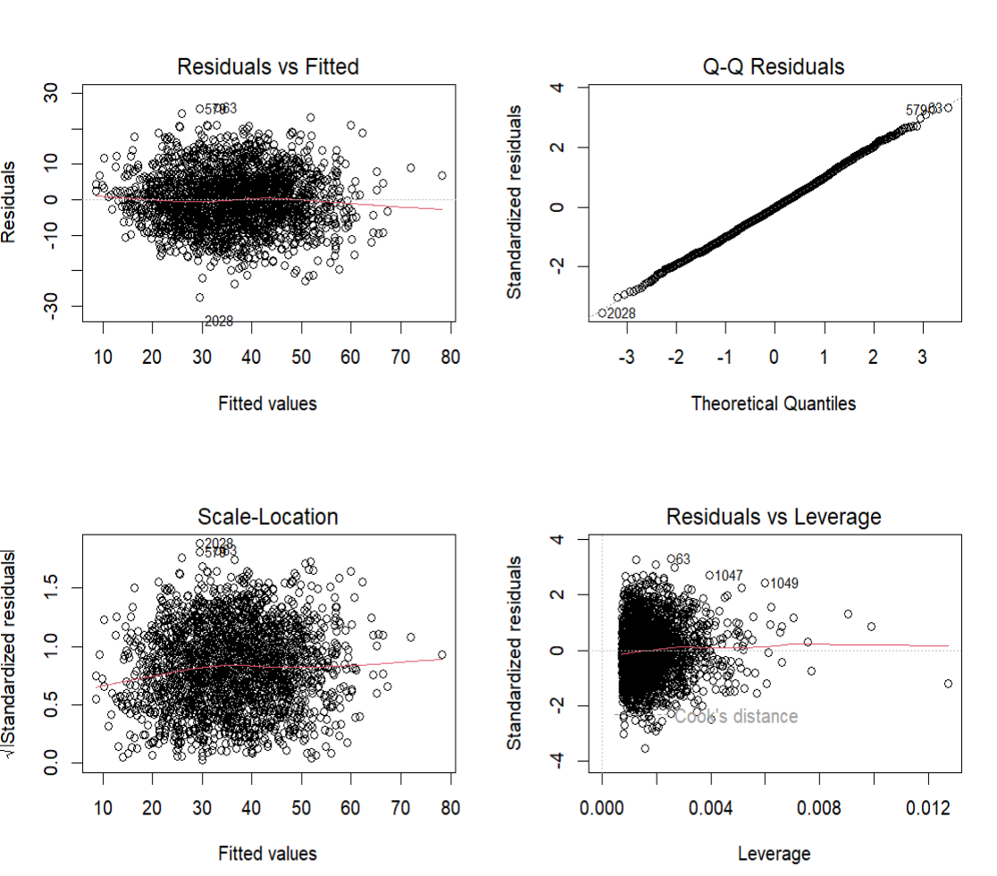
Data example!

Slide 70
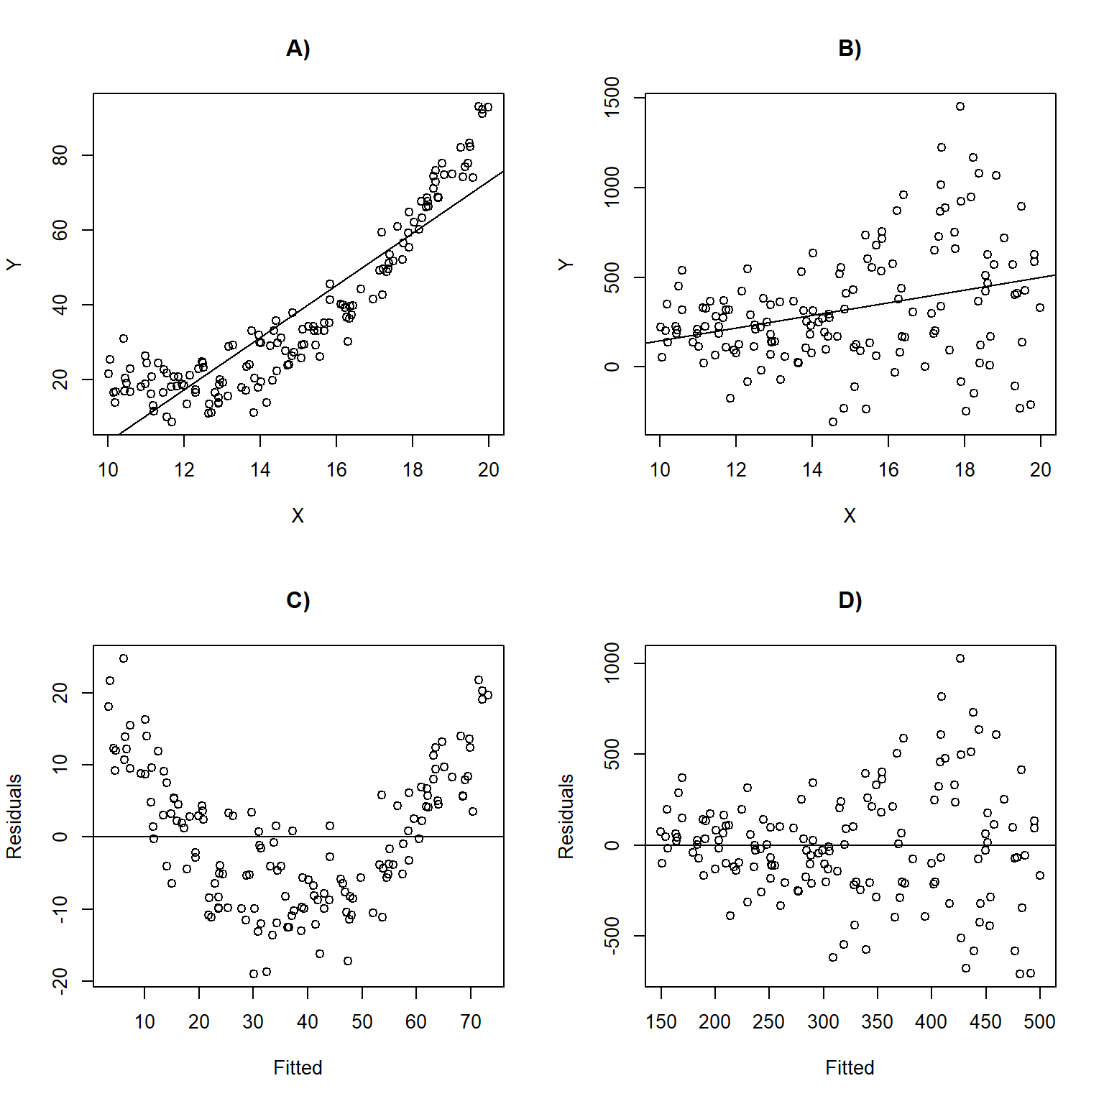
Bad residuals
What is wrong with these?

Slide 71
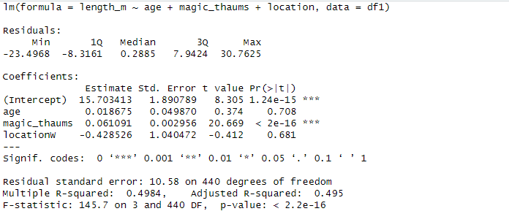
Data example!
Step 3: Run chosen statistical test (full version)

Slide 72
Data Example!
Step 5: Interpret and report out findings
“Ambient background magic significantly, and positively, correlated with whale length (linear regression: F(3, 440) = 145.5, p<0.001); on average, length increased by 0.06m per unit of magic. There was no significant correlation between age and length (p=0.71), nor was there a significant difference between Eastern and Western sites (p=0.68).
Alternatively: provide a table with estimates, SE, t-values and p-values! For models with lots of variables, this can be much easier.

Slide 73
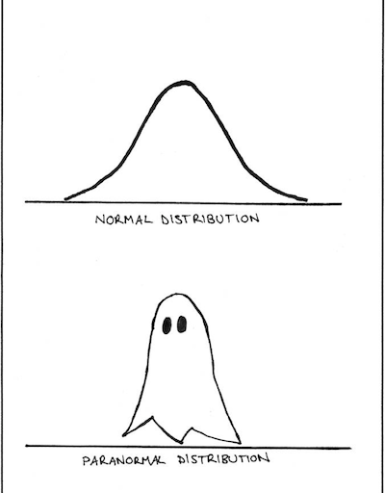
Congratulations!
EVERY frequentist model in R (based on a GLM) works in a similar manner to what we just went through. They are all extensions of least squared regression
The only difference is:
They are designed to work with different types of response data (e.g. categorical, binomial etc.)
They are designed to work with different distributions
They have different assumptions

Slide 74
Next steps
Response variables is… | Predictor | Response variable distribution | Possible test
Binary (0/1) | 1 or more categories | binomial | Binomial test
Count | >=2 categories | Chi-squared | Chi-squared test
Continuous | 2 categories | Normal | Linear model with 2 categories
Continuous | 2 categories | Student’s t-distribution | t-test
Continuous | >2 categories | Normal | Linear model with >2 categories (variant: ANOVA)
Continuous | Continuous | Normal | Linear Regression
Continuous | Continuous + Categorical | Normal | Linear Regression (aka multiple linear regression
Count | Continuous + Categorical | ????? | ?????
Binary (0/1) | Continuous + Categorical | ????? | ?????
Proportion | Continuous + Categorical | ????? | ?????
… | … | … | …

Slide 75

Questions

Slide 76
Next time…
Learning more distributions!
GLMs!
What to do if there is no distribution that fits
Non-parametric tests
Adding bells and whistles
Random effects
Model comparisons
AIC and so on…

Slide 77
The Practical: Part 2
https://github.com/HakkinenH/Rcourse2026
Code -> download ZIP -> Unzip and put somewhere useful
Run 0Packages.R first ((if you haven’t already) to install packages
Work through 3LM.R
Then pick whatever topic you like from there!

Slide 78
Further resources
I used these heavily for examples and scripts in this course:
https://statistics4ecologists-v3.netlify.app
https://bookdown.org/ndphillips/YaRrr/
https://r.qcbs.ca/workshop06/book-en/reviewing-linear-models.html
https://saestatsteaching.tech/nonparametric-methods
https://r.qcbs.ca/workshop07/book-en/mixed-model-protocol.html
https://cran.r-project.org/web/packages/DHARMa/vignettes/DHARMa.html
https://www.flutterbys.com.au/stats/tut/tut8.4a.html
https://noamross.github.io/gams-in-r-course

Slide 80
Extra Slides

Slide 81
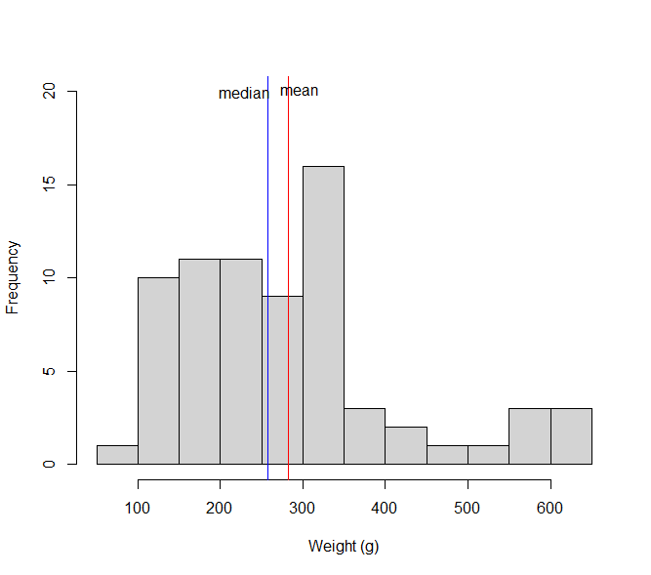
Descriptive Statistics
Mean and median:
Tells us the “average” value, but little else
Very few individuals are actually average, so we need other ways to describe data

Slide 82
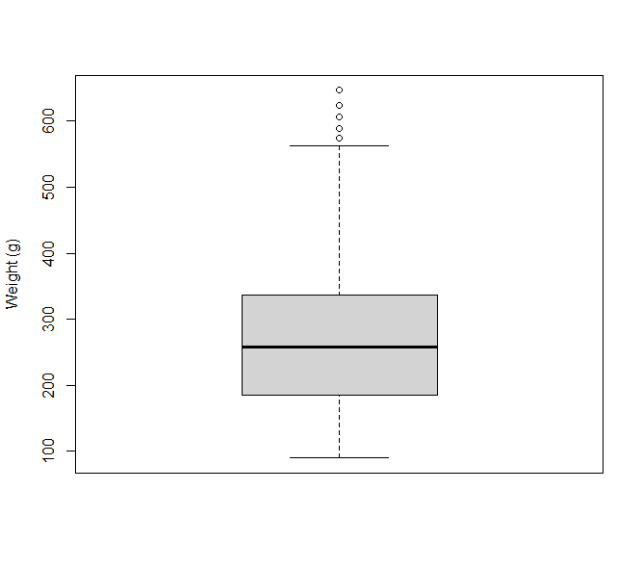
Descriptive Statistics
Range:
Minimum and maximum values
Useful, but outliers can be misleading!
Interquartile range
25th and 75th percentile
Also useful!

Slide 83
Descriptive Statistics
In statistics we talk a lot about “variance around the mean”, or “on average, how close are individuals to being average”?
The Mean Absolute Deviance is the average of how far each data point is from the mean -> 68g.
On average a chick will be 68g lighter or heavier than the mean.

